Slide 1
Classroom Technology
Professor Richard Anderson
Department of Computer Science and Engineering
University of Washington
August 10, 2006

Slide 2
Today’s talk
Introduction to Classroom Technology
We will use the technology we are using in University of Washington classes
  However, this is a brand new version of the software
How can technology enhance the university lecture?
What are the challenges and risks of using technology in the classroom?

Slide 3
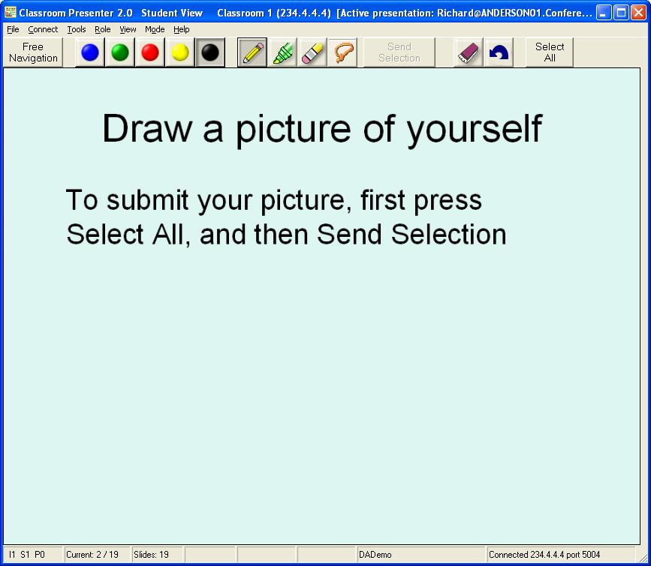
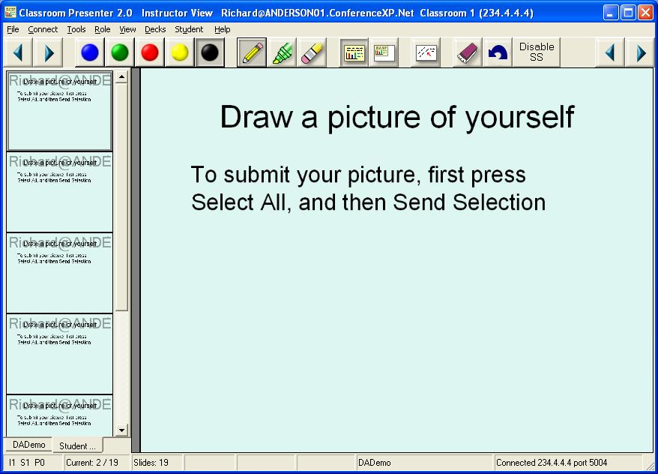
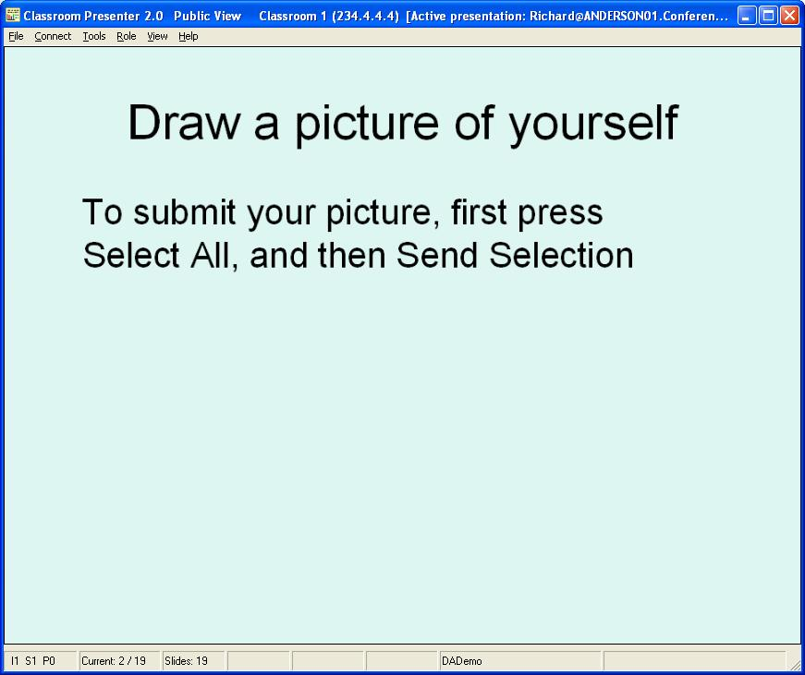
Classroom Presenter

Slide 4
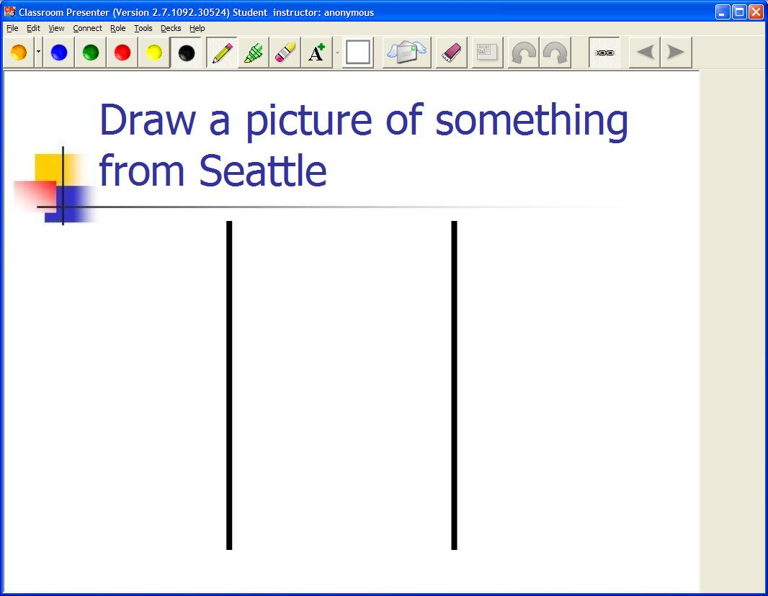

Student Interface
Student Submission

Slide 5
Draw a picture of something from Seattle
Student Submission

Slide 6

Where are you from?
Student Submission

Slide 7
What will the university classroom look like . . .
If all students have computational devices
  Laptops, Tablets, Ultralight Tablets, PDAs, Smart Phones, Gameboys . . .
  If the devices are all connected
  If the devices are integrated into classroom instruction

Slide 8
What applications would students or instructors use in the classroom?
Student Submission

Slide 9
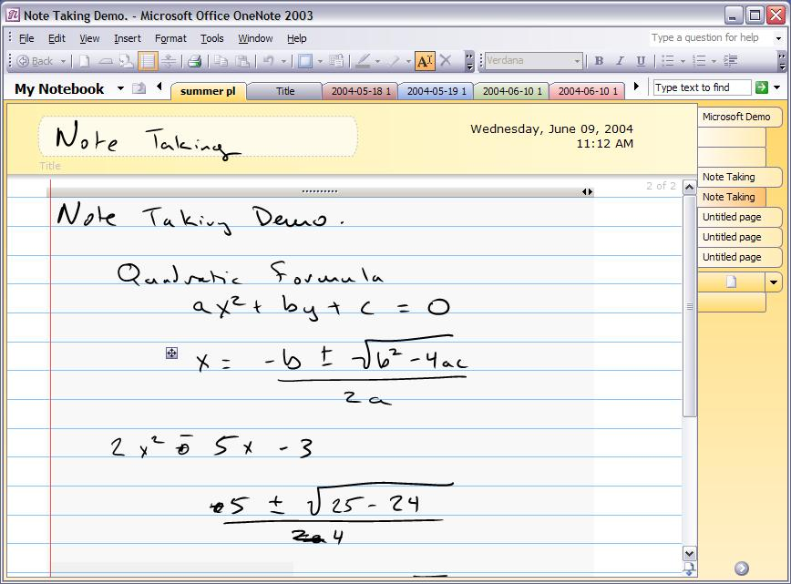
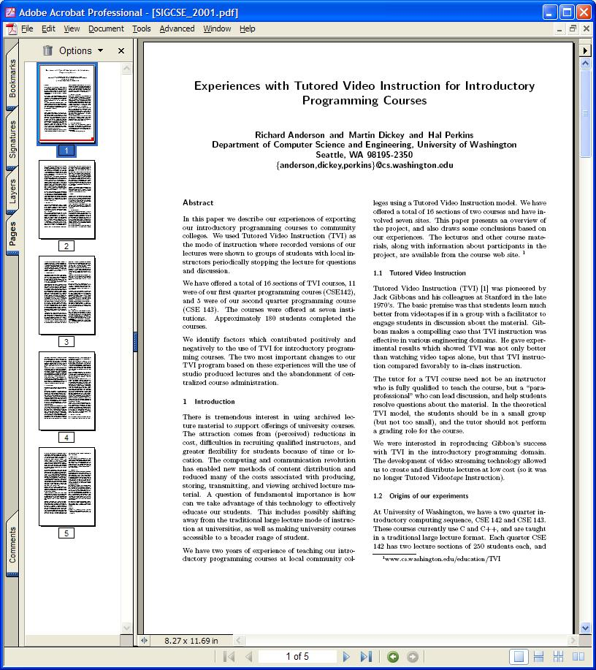
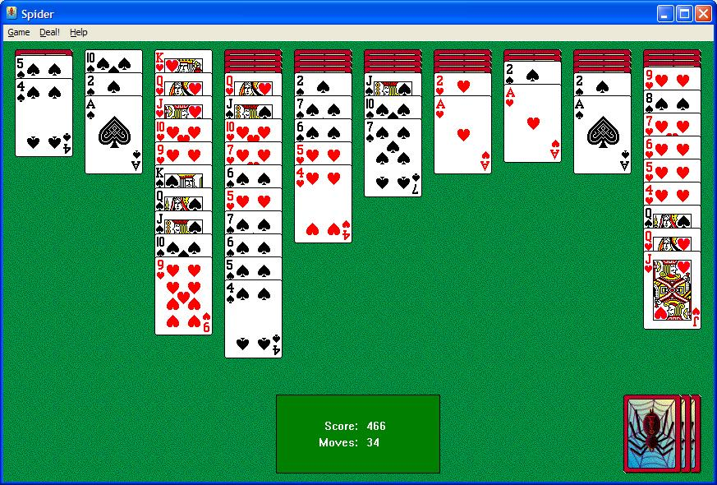
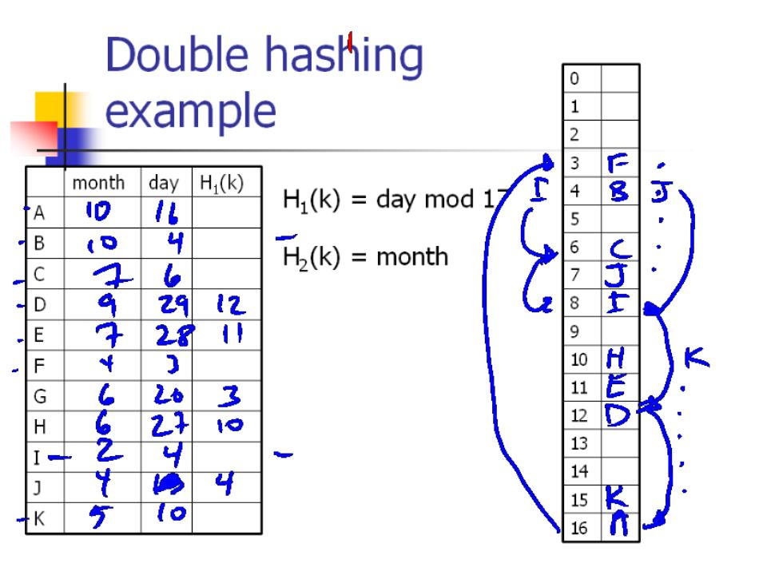
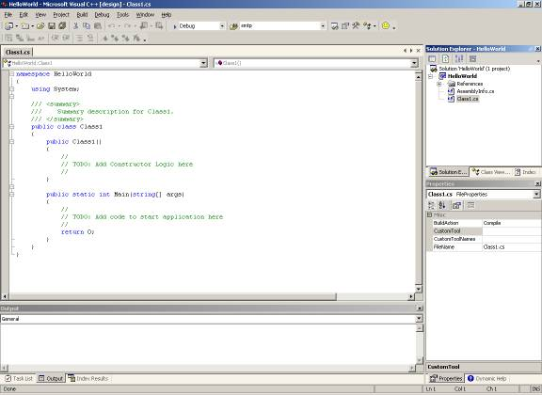
Wide range of potential classroom applications
Presentation
Demonstration
Simulation
Accessing external resources
Note taking
Feedback
Active learning
Peer communication

Slide 10
Classroom Presenter
Tablet PC Based Presentation System
  Initially developed at MSR (2001-2002)
  Continued development at University of Washington
  Built on ConferenceXP Research Platform
Ink Based Presentation
Distributed Classroom
Classroom Interaction

Slide 11
Ink Based Presentation
Combine digital ink with electronic slides
Tablet PC
  Windows XP Computer
  Pen based input
  High quality digital ink

Slide 12
Collective Brainstorm:
What are the benefits of slides and ink?
Benefits of slides
Benefits of ink
Student Submission

Slide 13
Collective Brainstorm
What are the benefits of slides and ink?
Benefits of slides
Benefits of ink

Slide 14
Classroom Interaction
Provide additional interaction channels for students
Use these to achieve specific pedagogical goals in class
Why electronic interaction?
  Bandwidth – more students can contribute
  Expressiveness
  Simultaneous
  Anonymous
  Persistent

Slide 15
Student Attention vs. Time
Attention
10 20 30 40 50 60 Time
Student Submission

Slide 16
Pedagogical Goals
Encourage students to contribute in multiple ways
Promote engagement in the class
  Interest
  Alertness
Demonstrate that all students have important opinions
Peer interaction

Slide 17
Pedagogical goals
Feedback – classroom assessment
Collection of ideas
  Collective brainstorm
Student generation of examples
Discovery of a pedagogical point
Gain understanding of an example
Show misconceptions

Slide 18
What concerns would you have about using Tablet PCs in the Classroom?
Student Submission

Slide 19
CLASSROOM PRESENTER
www.cs.washington.edu/education/dl/presenter
For more information, contact
Richard Anderson
anderson@cs.washington.edu

